Slide 1

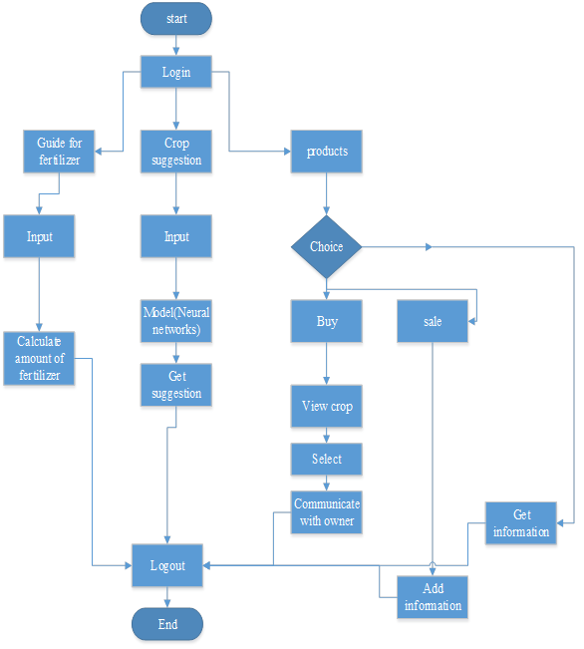
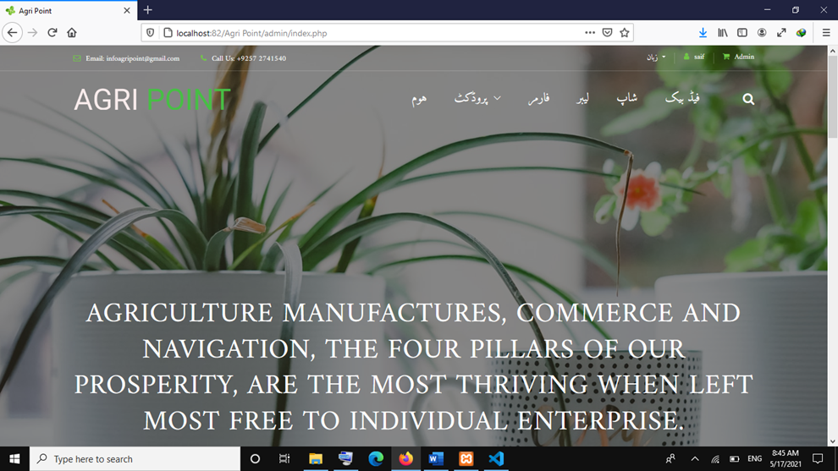
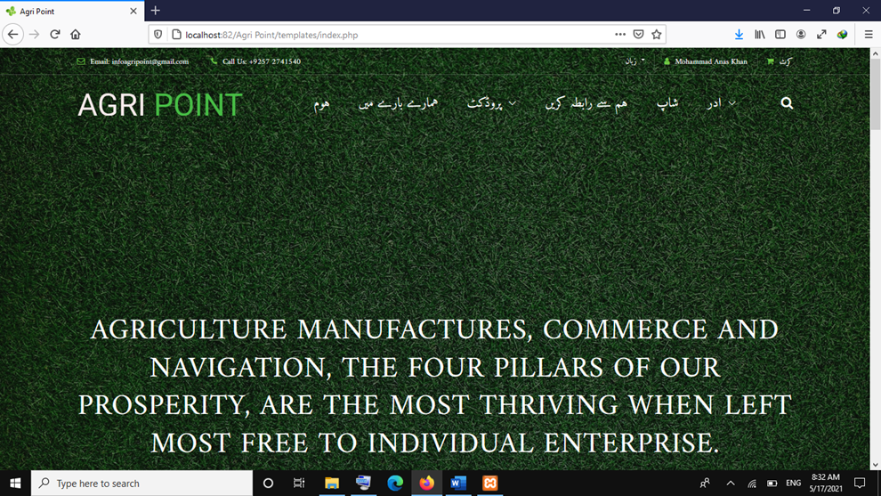

^{Agri Point} ^{Final Year Project (2017-2021)} ^{Department of Computer Science} COMSATS University Islamabad, Attock Campus
Introduction
Keeping in view the problems faced by farmers, we intend to form a website which can bring solution to these problems on one platform and give an opportunity to the farmers and open up before them a new horizon leading them to brighter future ahead. It helps the farmers to improve their productivity. It also helps the farmers to buy and sale the certified seeds and fertilizers etc. In this website farmers can get information which crop to be grown for particular climate which increase the crop productivity. Farmers can heir the laborers and get information about different products. In addition, farmers can calculate the amount of fertilizer for land
Motivations
If farmer want to sale any product i.e. agricultural produce etc. He can add information(name, quantity and price ) about products. And user who want to buy product can view it and if he like the product He can buy product from owner with the help of website communication feature.
User can get information about climate and also get information which crop to be grown for particular climate.
Farmers can share their views and their experience. They can interact with agricultural expert there.
System Background
There are various reasons which are responsible for bad performance of the agricultural sector which includes lack of awareness of modern technology and procedures, inability to find buyer of their produce, lack of information about different national and international development schemes..
Architecture
Results
Admin Portal
Conclusion
This Web will surely help the Farmers to grow crops according to the situation of temperature, soil and will eventually get larger amount of production. It will also help the individual farmers to calculate recommended of fertilizer for each crop. In addition to that this system has an option where farmers can buy inputs i.e. seeds, fertilizers etc. and to sale out their products. Along with that this system also has an information tab where farmers can get information about agriculture from agricultural experts through messaging. Moreover, farmer can heir laborer according to their needs.
User Portal
Future Directions
In future this work can be shifted to android application with minimal internet requirement.
Crop disease detection and advisory feature can be added by utilizing artificial intelligence.
Another module can be added which can bring in call feature for interaction of farmers and laborer
Objectives
The key objective behind formation of this website is to address the problems of the farmers for betterment of agriculture . As better the standard of farming the better will be the economy. It helps the farmers to increase their productivity. Farmers get information about agriculture in Urdu language.
Group Members
Mohammad Anas Khan
Fa17-bcs-003@ciit-attock.edu.pk
Saif ur Rehman
Fa17-bcs-007@ciit-attock.edu.pk
Supervisor: Name Miss Tahira Sadaf

